Slide 1


PREDICTING UFC PAY PER VIEW BUYS
JENNIFER PHAN

Slide 2
Quick Background
Ultimate Fighting Championship founded in 1993
Pay Per View Buys make up 30% of UFC’s revenue
Today PPV costs are between $49.99 to $59.99

Slide 3
Data collection

Slide 4
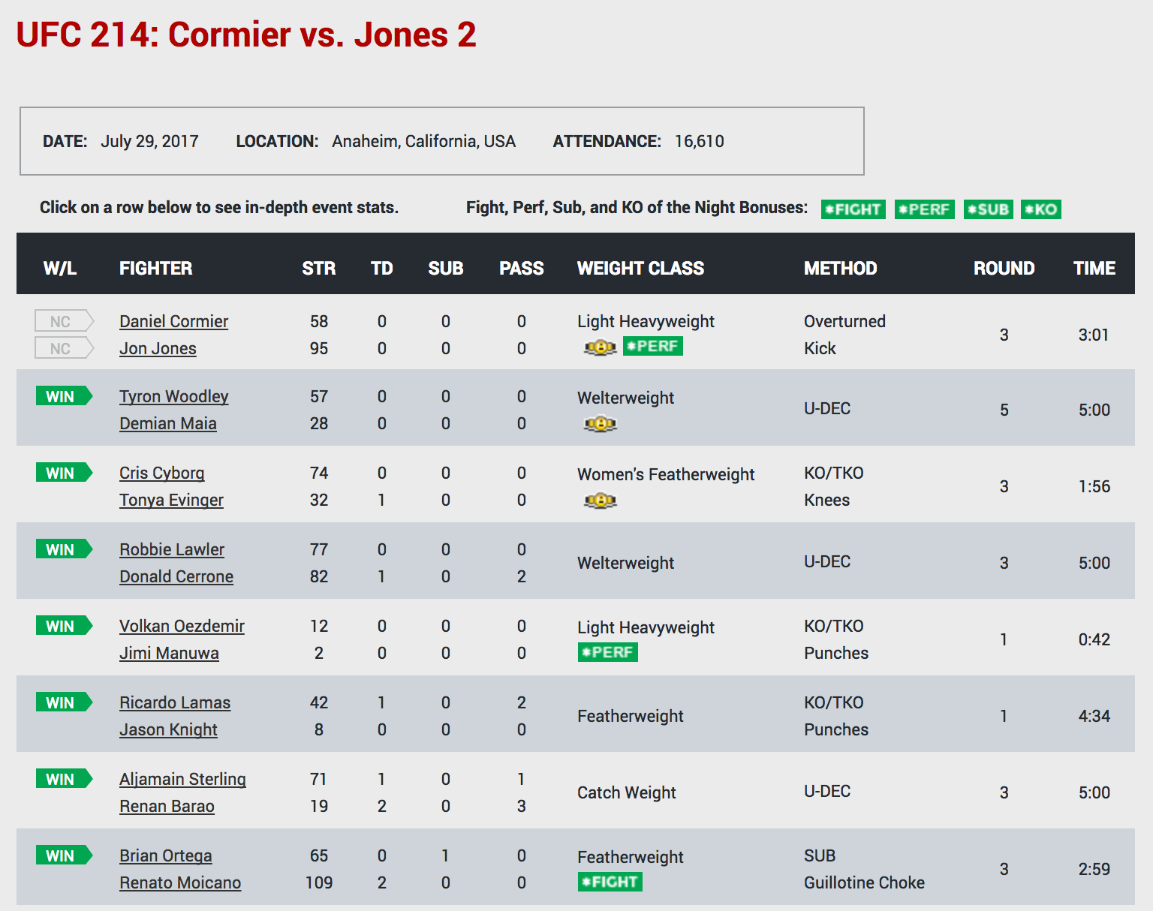
Rematch
Rivalry
Belt
Women’s fight
Source: FightMetric

Slide 5
Explored Features
Ticket Revenue (Live Gate)
Attendance
TV Ratings (viewers)
Personal Rivalry
Total # of Strikes, Submissions, Passes
Rematch
Number of Fights Per Event (Bouts)
Women Fights
Title Shot
Technical Fighters
Number of Rounds
Fight Time
Fan Favorites - McGregor, Silva, Rousey, Liddell, Lesnar, GSP
Finishes : KO, Sub., U-Dec
Lightweight vs Heavyweight

Slide 6
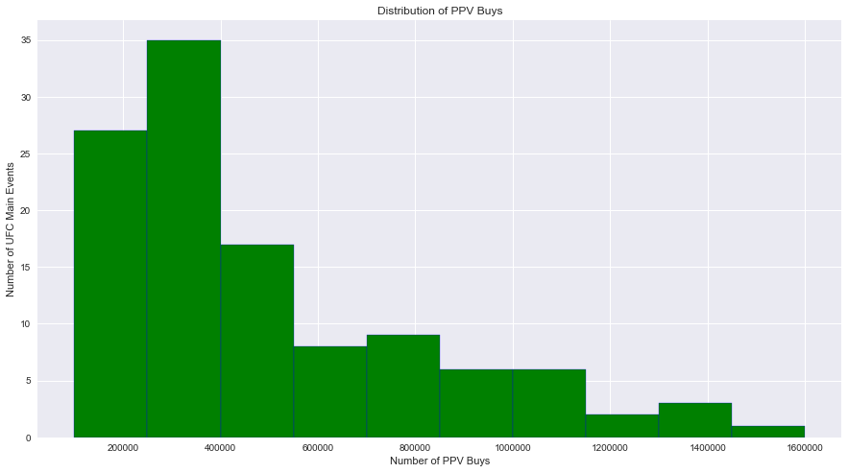

Slide 7
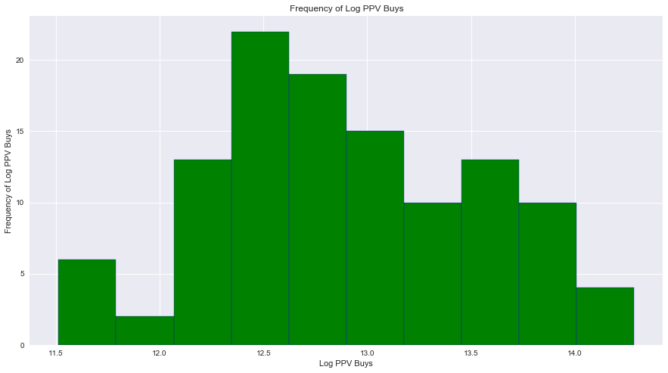

Slide 8
Linear Assumptions

Slide 9
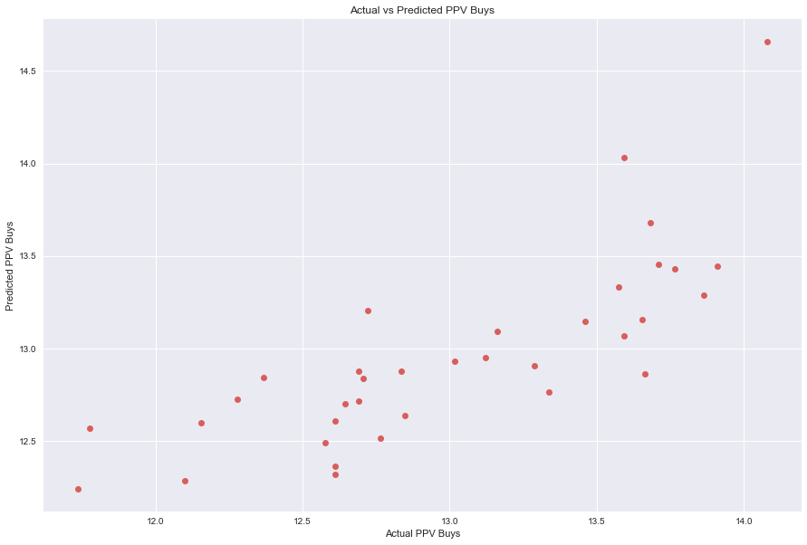
Regression is linear in parameters

Slide 10
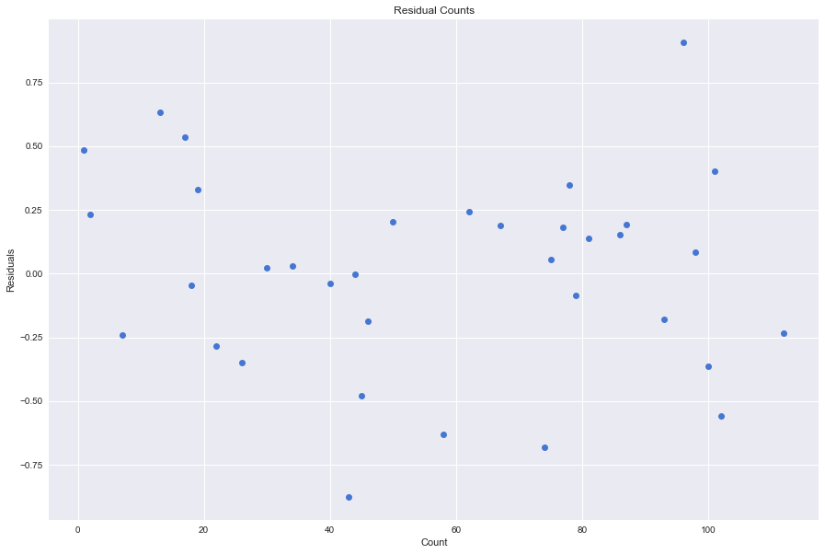
Residuals should be symmetric around y = 0

Slide 11
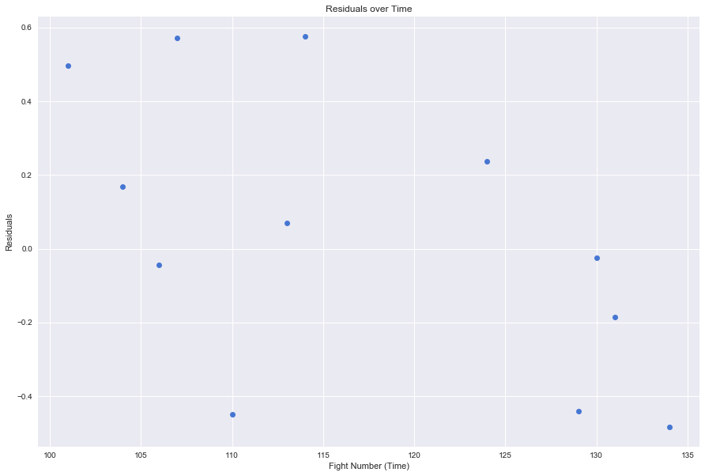
Errors are uncorrelated across observations

Slide 12
Regression Modeling

Slide 13
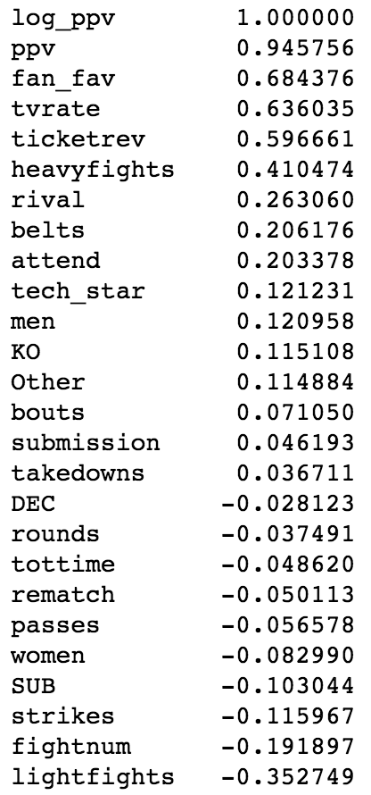
Correlations

Slide 14
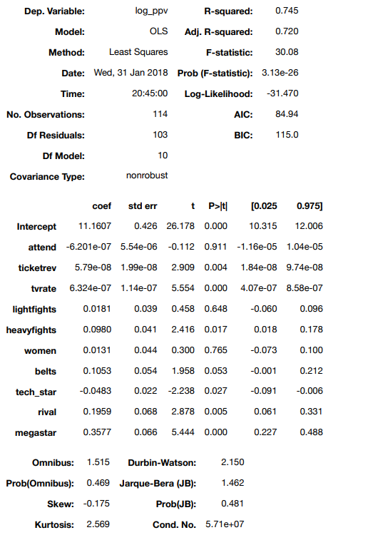


Slide 15
Train Test Split Test
Test model against an out of sample test set
30% data will designated as test set
R^2 = 0.66088393909462495
MSE for Train Set = 0.090737350014781171
MAE for Train Set = 0.24997090345011294
MSE for Test Set = 0.11580326376199075
MAE for Test Set = 0.26870784486413135

Slide 16
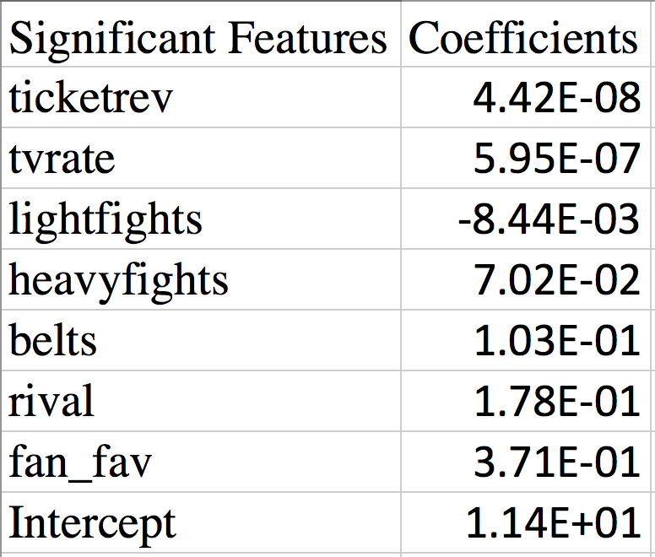
K-Fold Regression
Split data into 10 folds, each fold will have a chance to be tested against
Identify most statistical significant features with p-value < 2%
Mean R^2 = 0.64646311070047113

Slide 17
Can I improve my model?

Slide 18
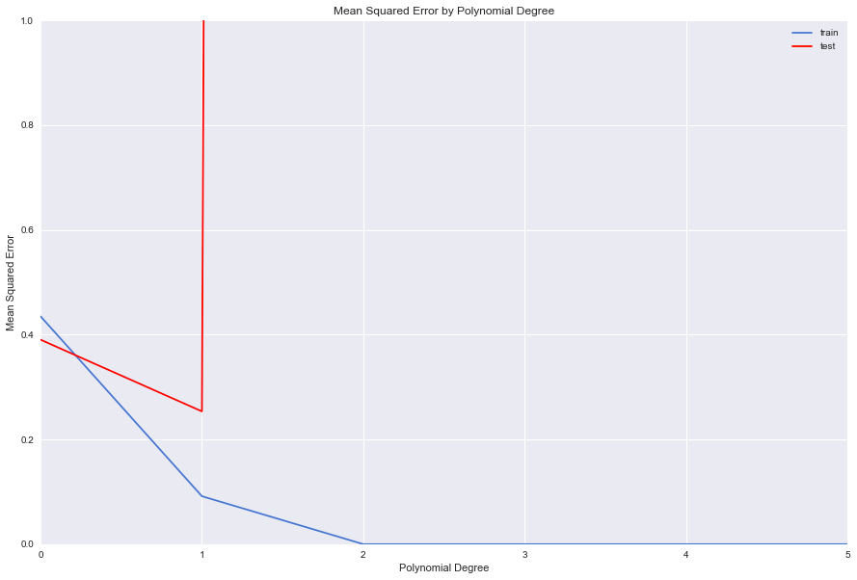
Optimal Degree is 1

Slide 19
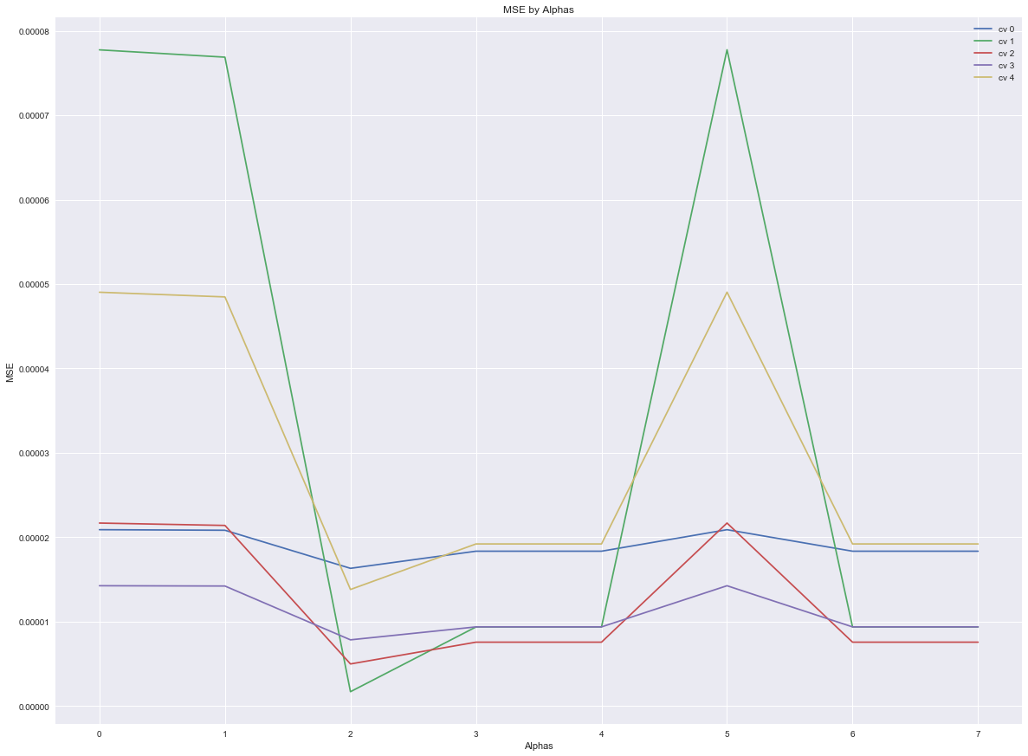
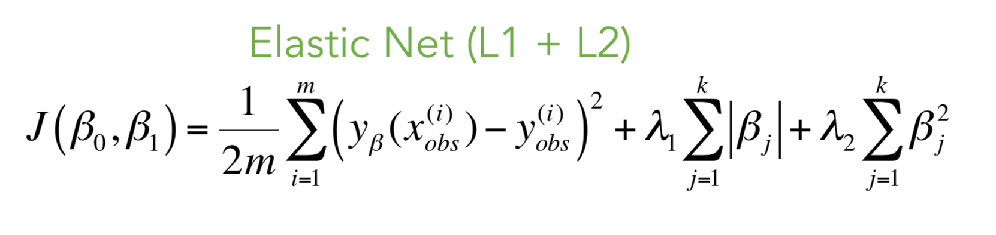
Elastic Net Regularization
α=[1e-10,1e-8,1e-5,1e-3,1e-1,0,1,100]
α = .00001

Slide 20
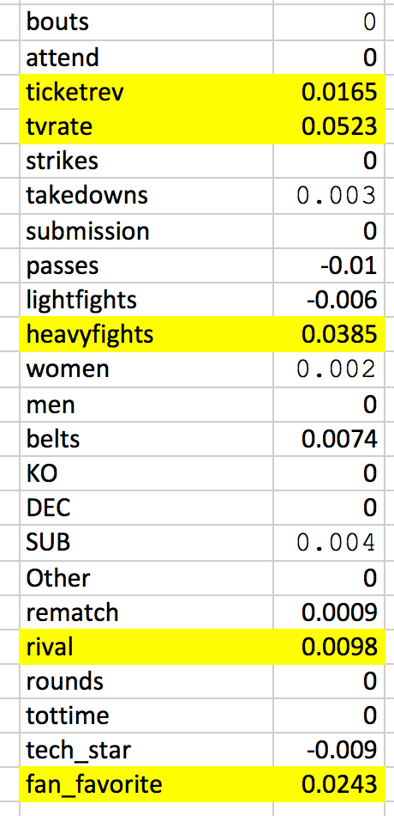
Elastic Net Cross Validation
Confirmed α = .00001 minimizes MSE
Score the model against test sets
R^2 = 0.63888186365287902
CV against training sets
MSE = 7.5015622479941857e-06
Lasso Ratio = .5

Slide 21
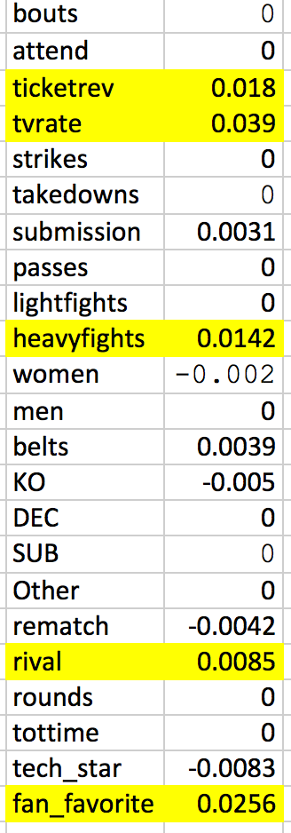
Lasso Regularization
Score the model against test sets
R^2 = 0.67809556073723098
CV against training sets
MSE = -6.78565721e-06
Eliminates Lightweight, passes, sub

Slide 22
Thank you.

Slide 23
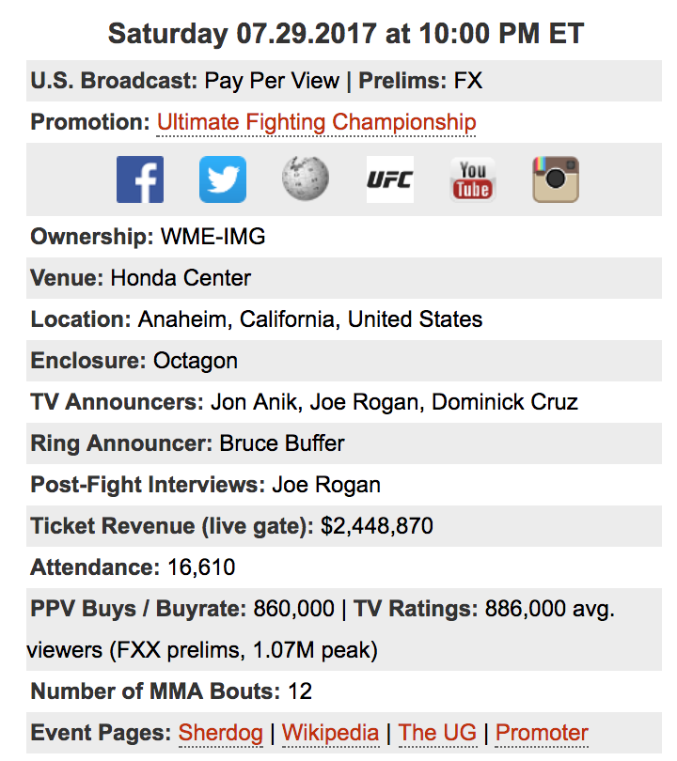
tapology.com

Slide 24
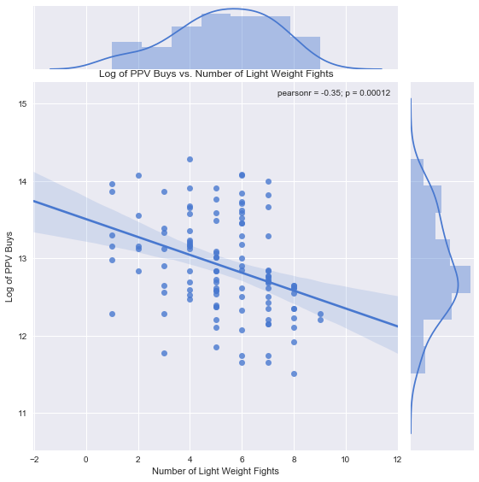

Slide 25
